Slide 1

Pet Loves Project
Making the perfect match between human and pet

Slide 2
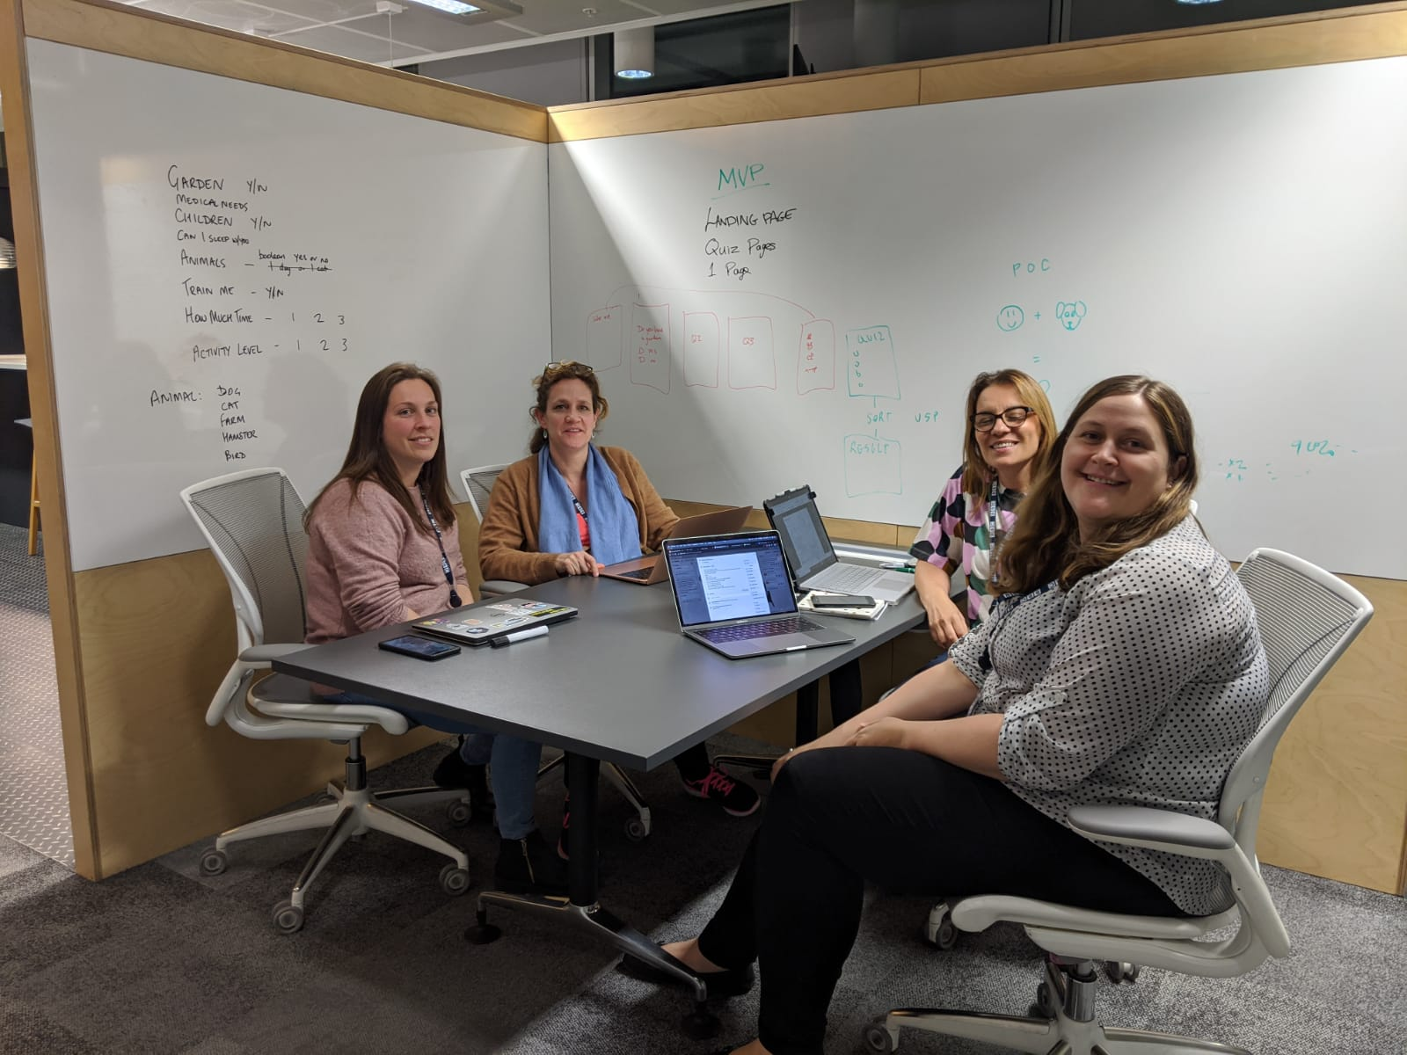
The Team!
Amelia
Laura
Jyoti
Lorna

Slide 3
Intro
We started off with an idea of matching pets with their ideal human.
The first thing we needed to do was to decide how we were going to go about this taking into account the limited time scale and bearing in mind Minimum Viable Product and Proof of Concept.

Slide 4
Concept/ Structure
Look and Feel
We wanted the site to have a friendly and warm feel about it so used soft colours and a cute logo paying homage to the Gitbhub logo!
(Put image of logo here)

Slide 5
We wanted to structure the app so that the landing page was a quiz asking some basic boolean questions of potential pet owners, such as:-
Do you have a garden?
How much time do you spend at home?
Do you have children?
Followed by a question, ‘what is your level of activity?’, with a slider question where you would place on the slider your level of activity. This would also help to determine the potential pet owners suitability for any particular pet.
This would then bring up and array of ‘pet cards’pulled from the database with a ‘Learn More’ button that when pressed would give individual information on each potential pet.

Slide 6
Work Process
With a mixture of stand up meetings in person and over Zoom, quad programming, pair programming we have worked on the shape and structure of the app.
This included:-
Setting up a Trello project where we inputted all of the resources, tasks, and materials we needed to complete the project.
Setting up and account on Github
Setting up a database on AWS LAMBDA using Mysql

Slide 7
Technology Used
We used a range of technology including:-
Scraper tool
React/Javascript
Trello
In Vision
Amazon Web Services
Web Scraper
Mysql database/ Amazon web services (LAMBDA)

Slide 8
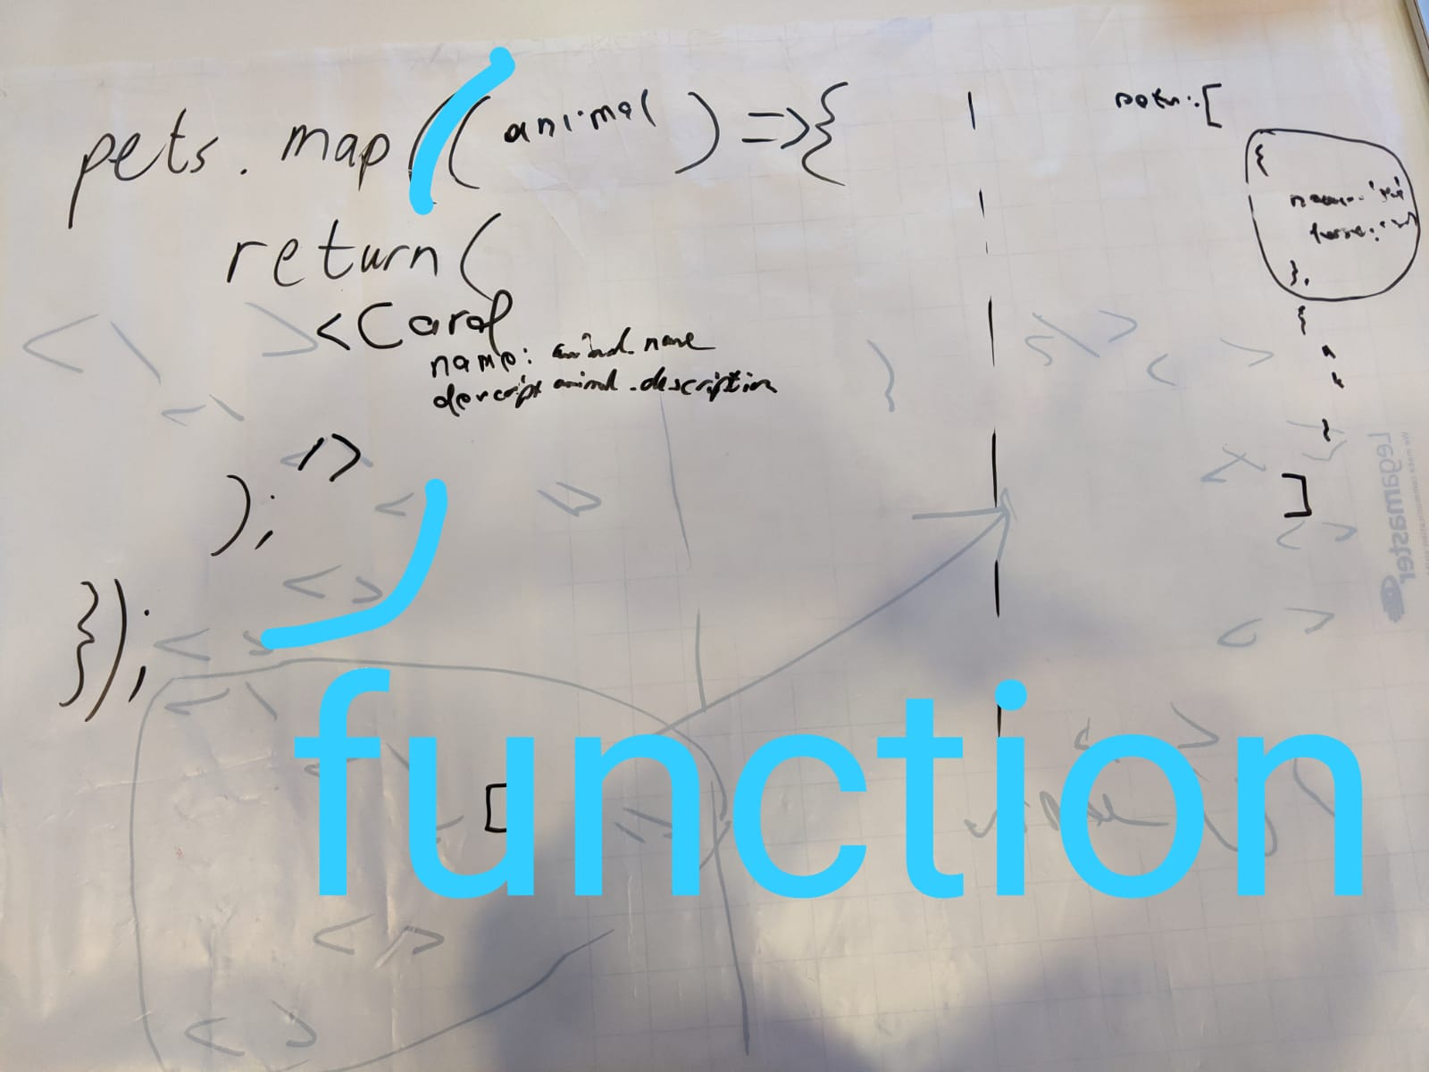
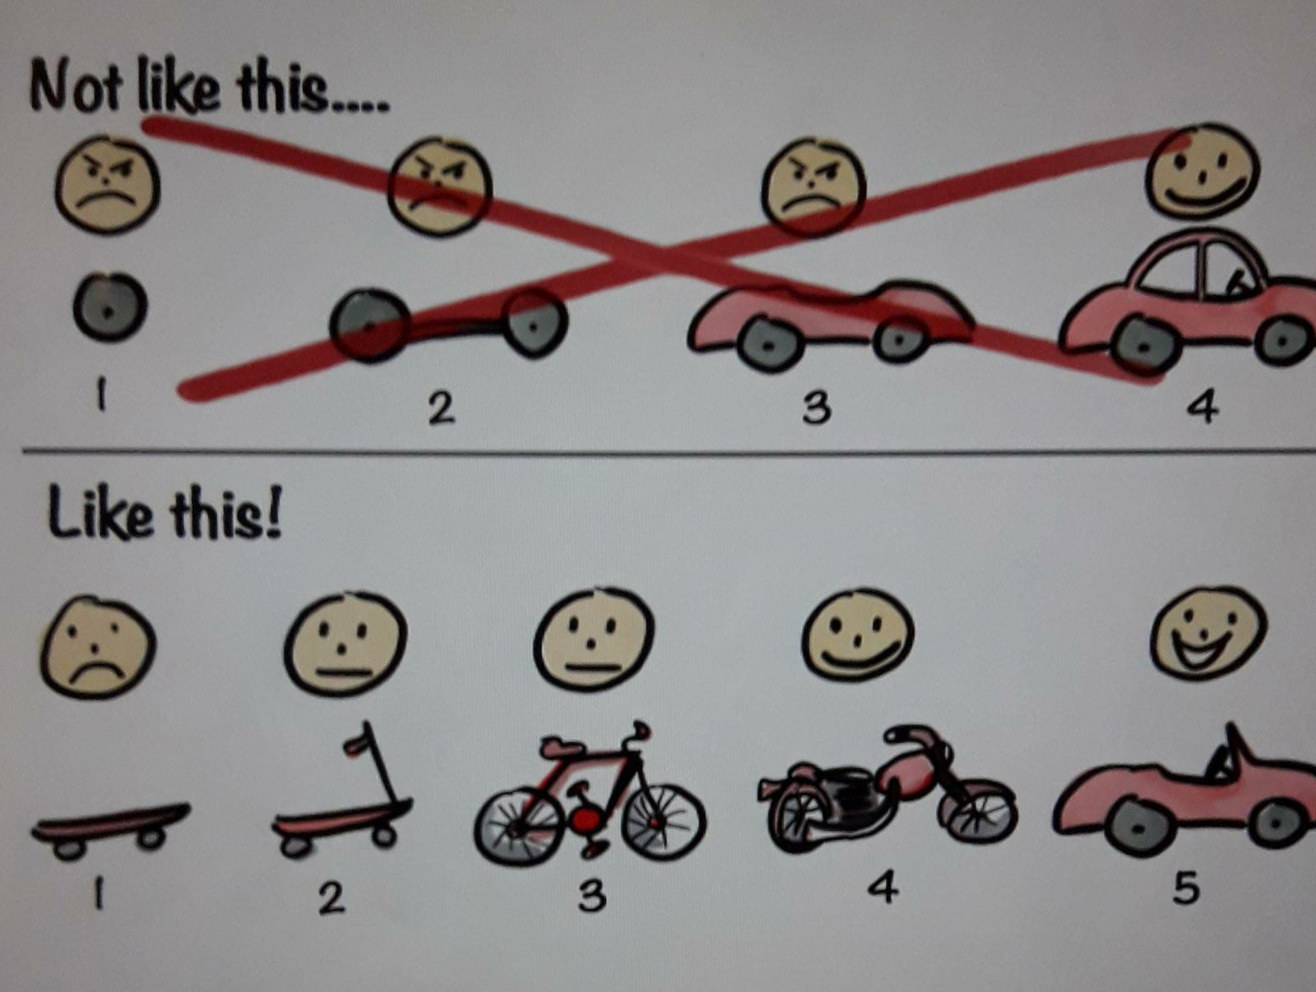
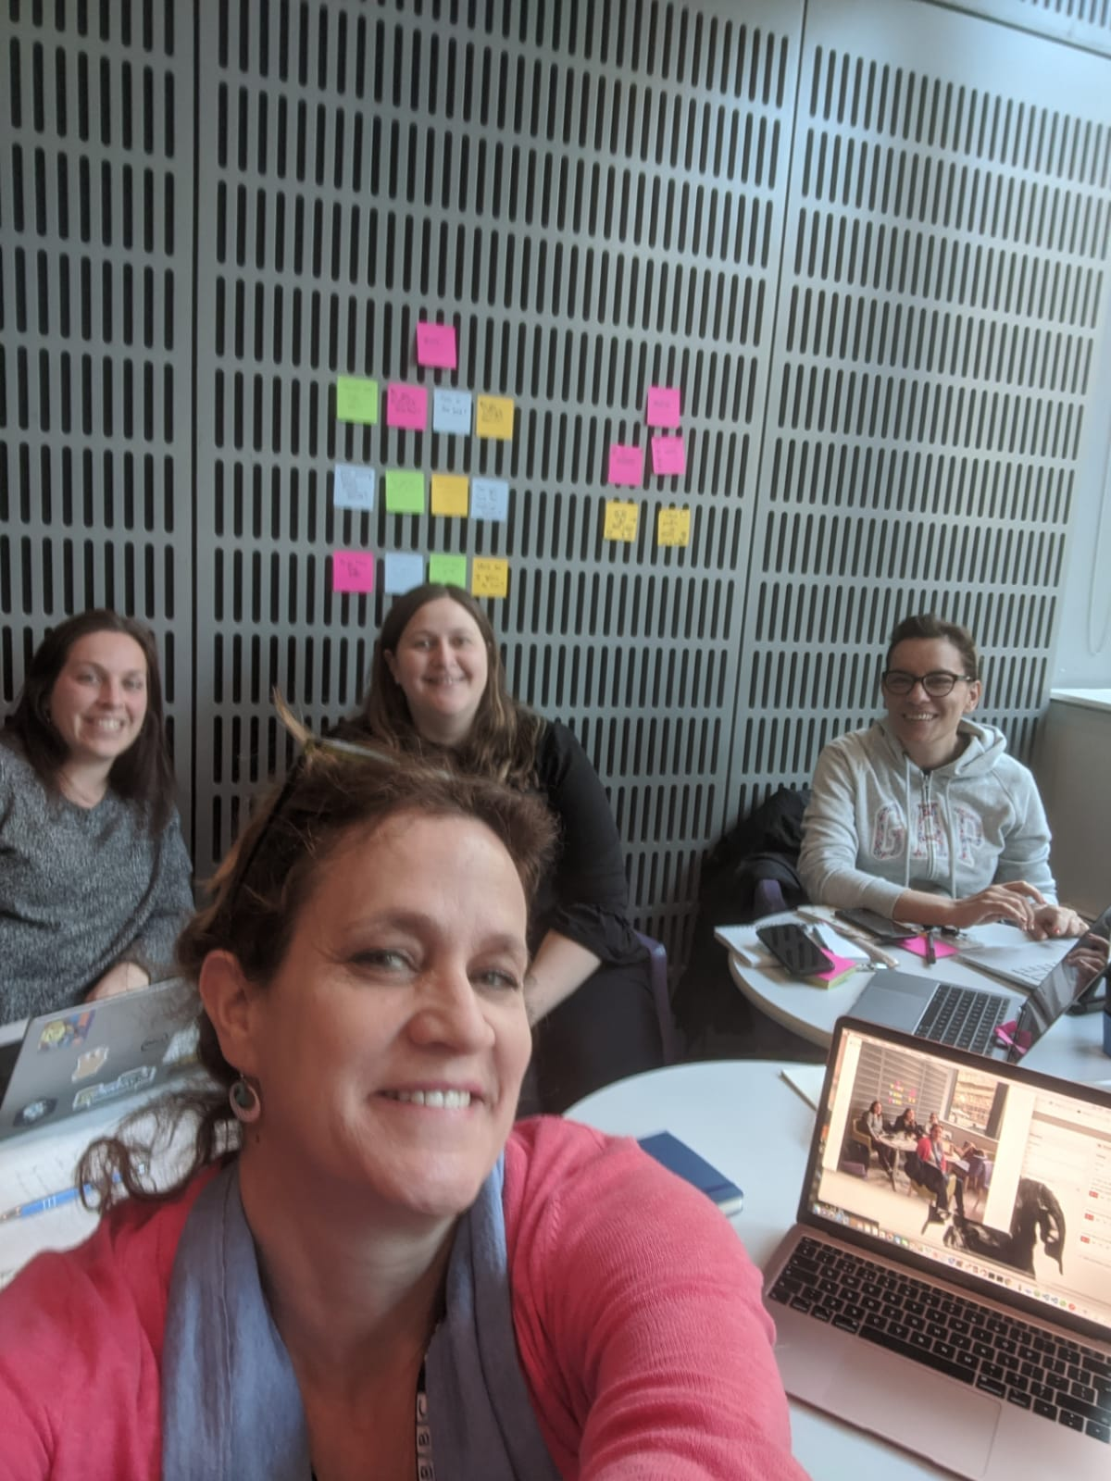
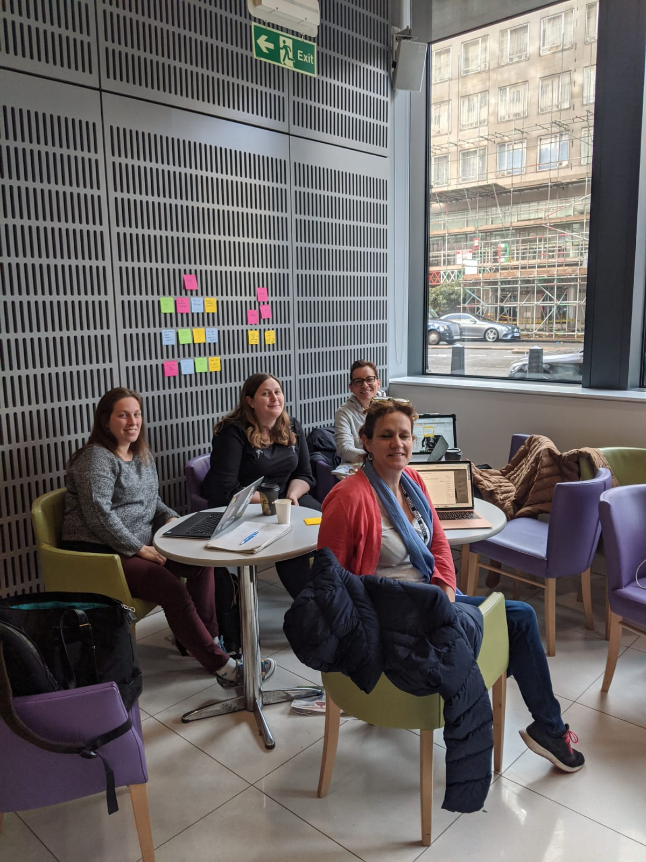
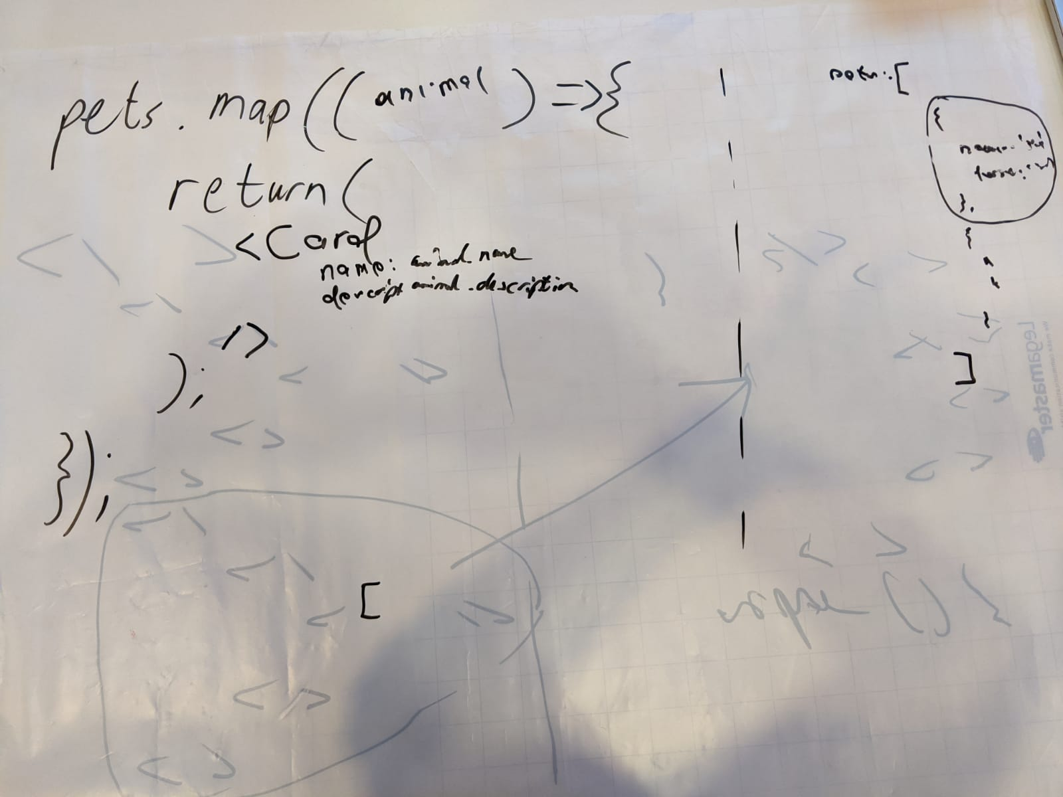
Whiteboard Discussions

Slide 9
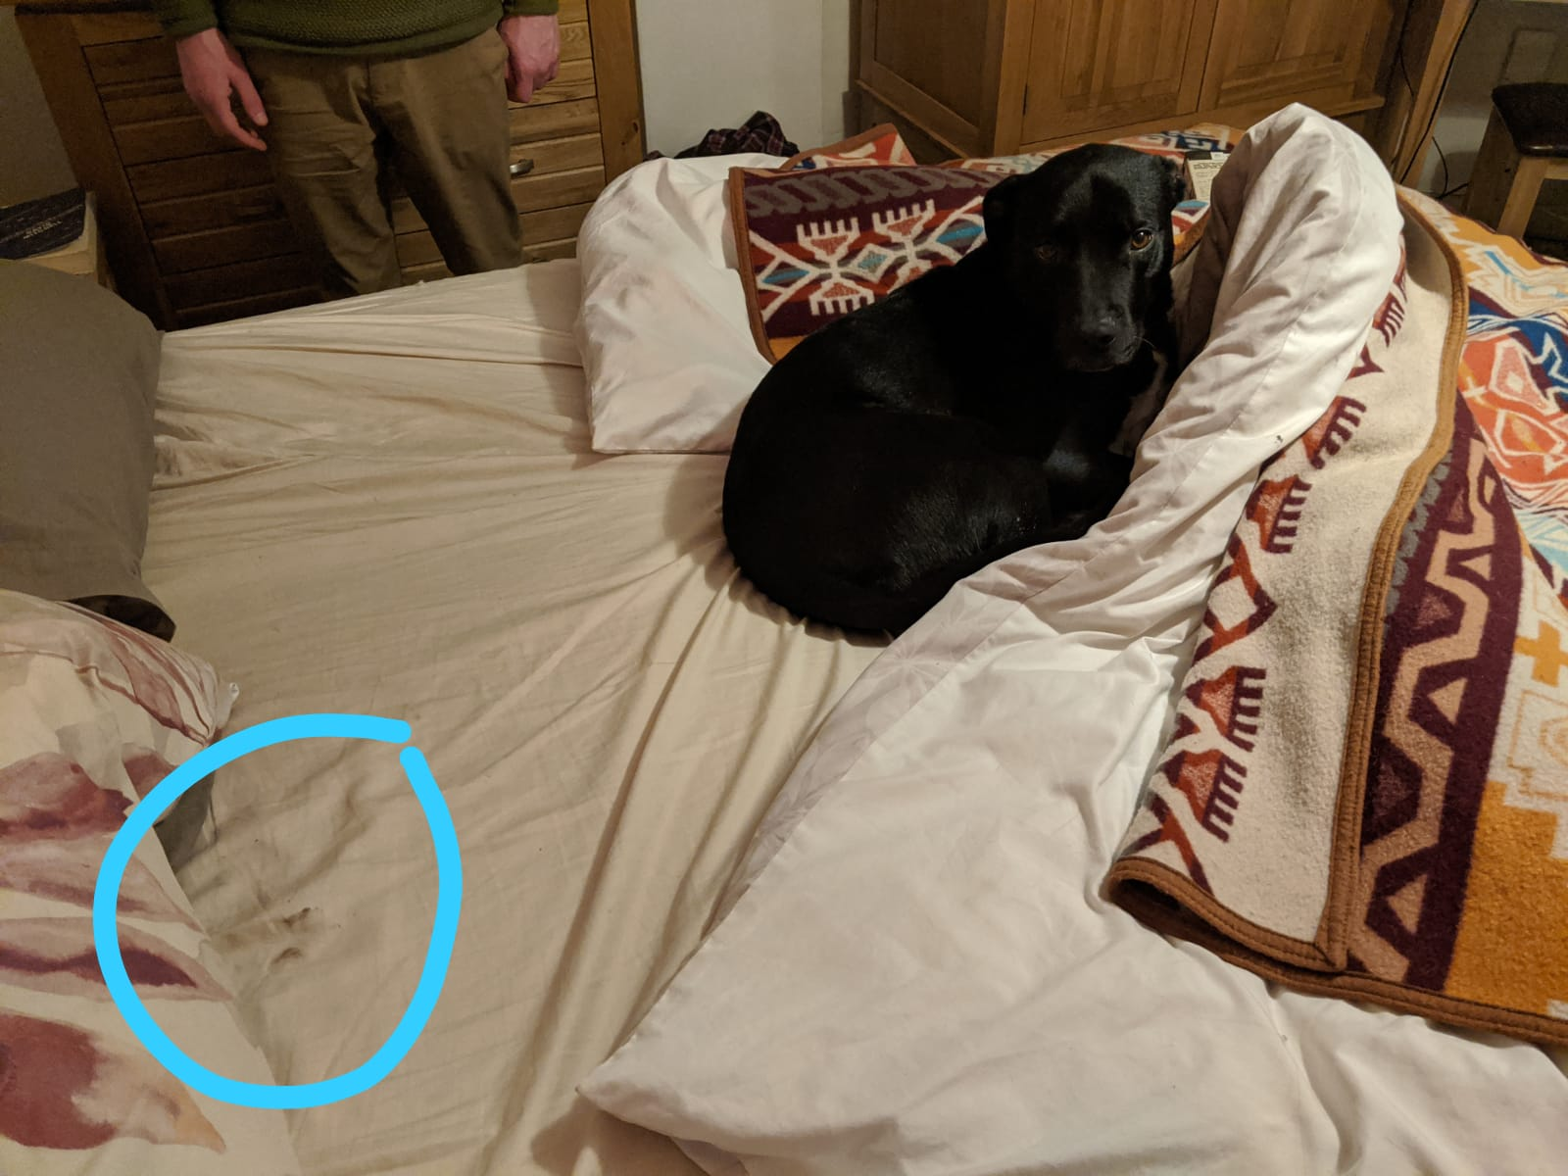
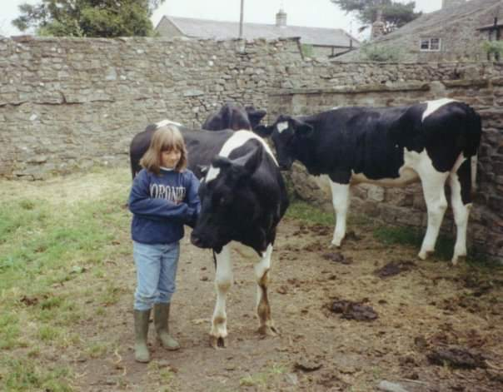
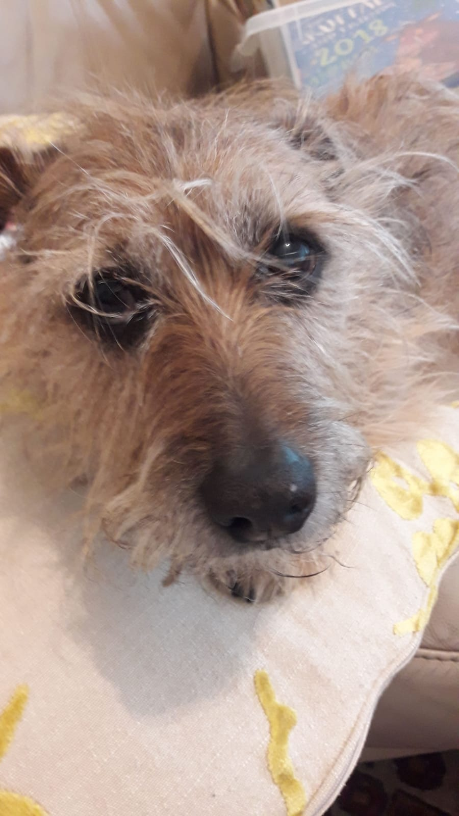
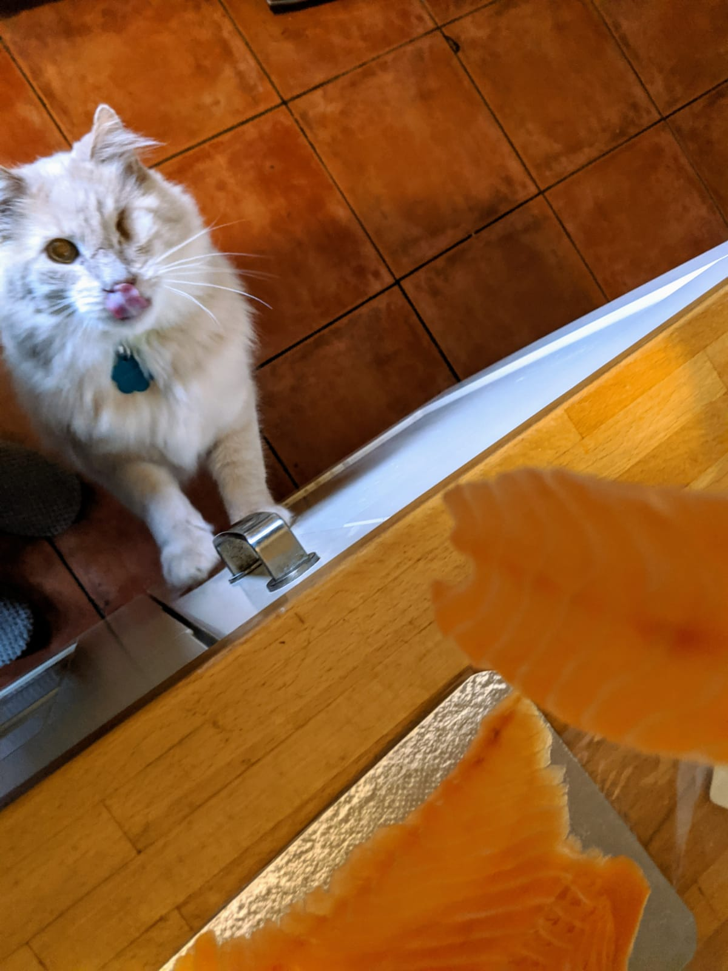
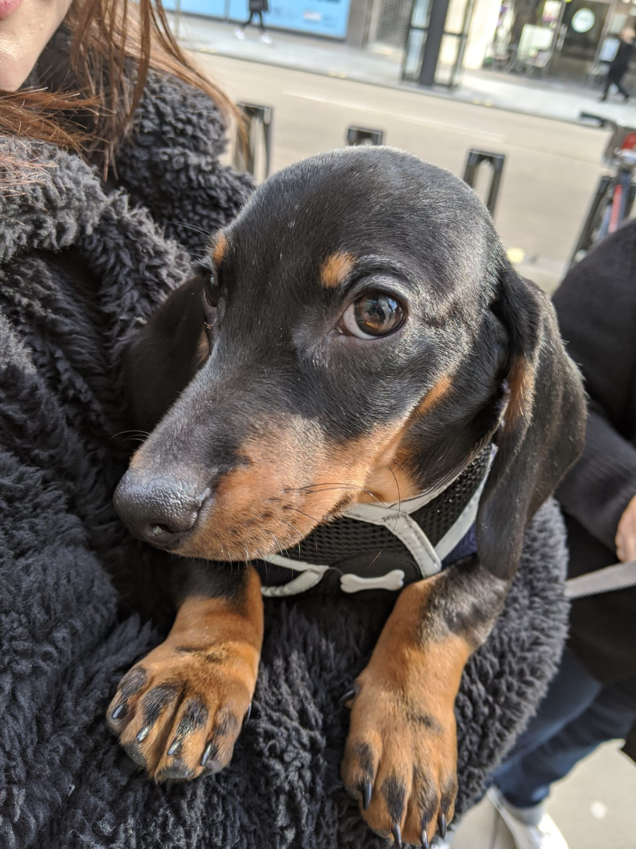
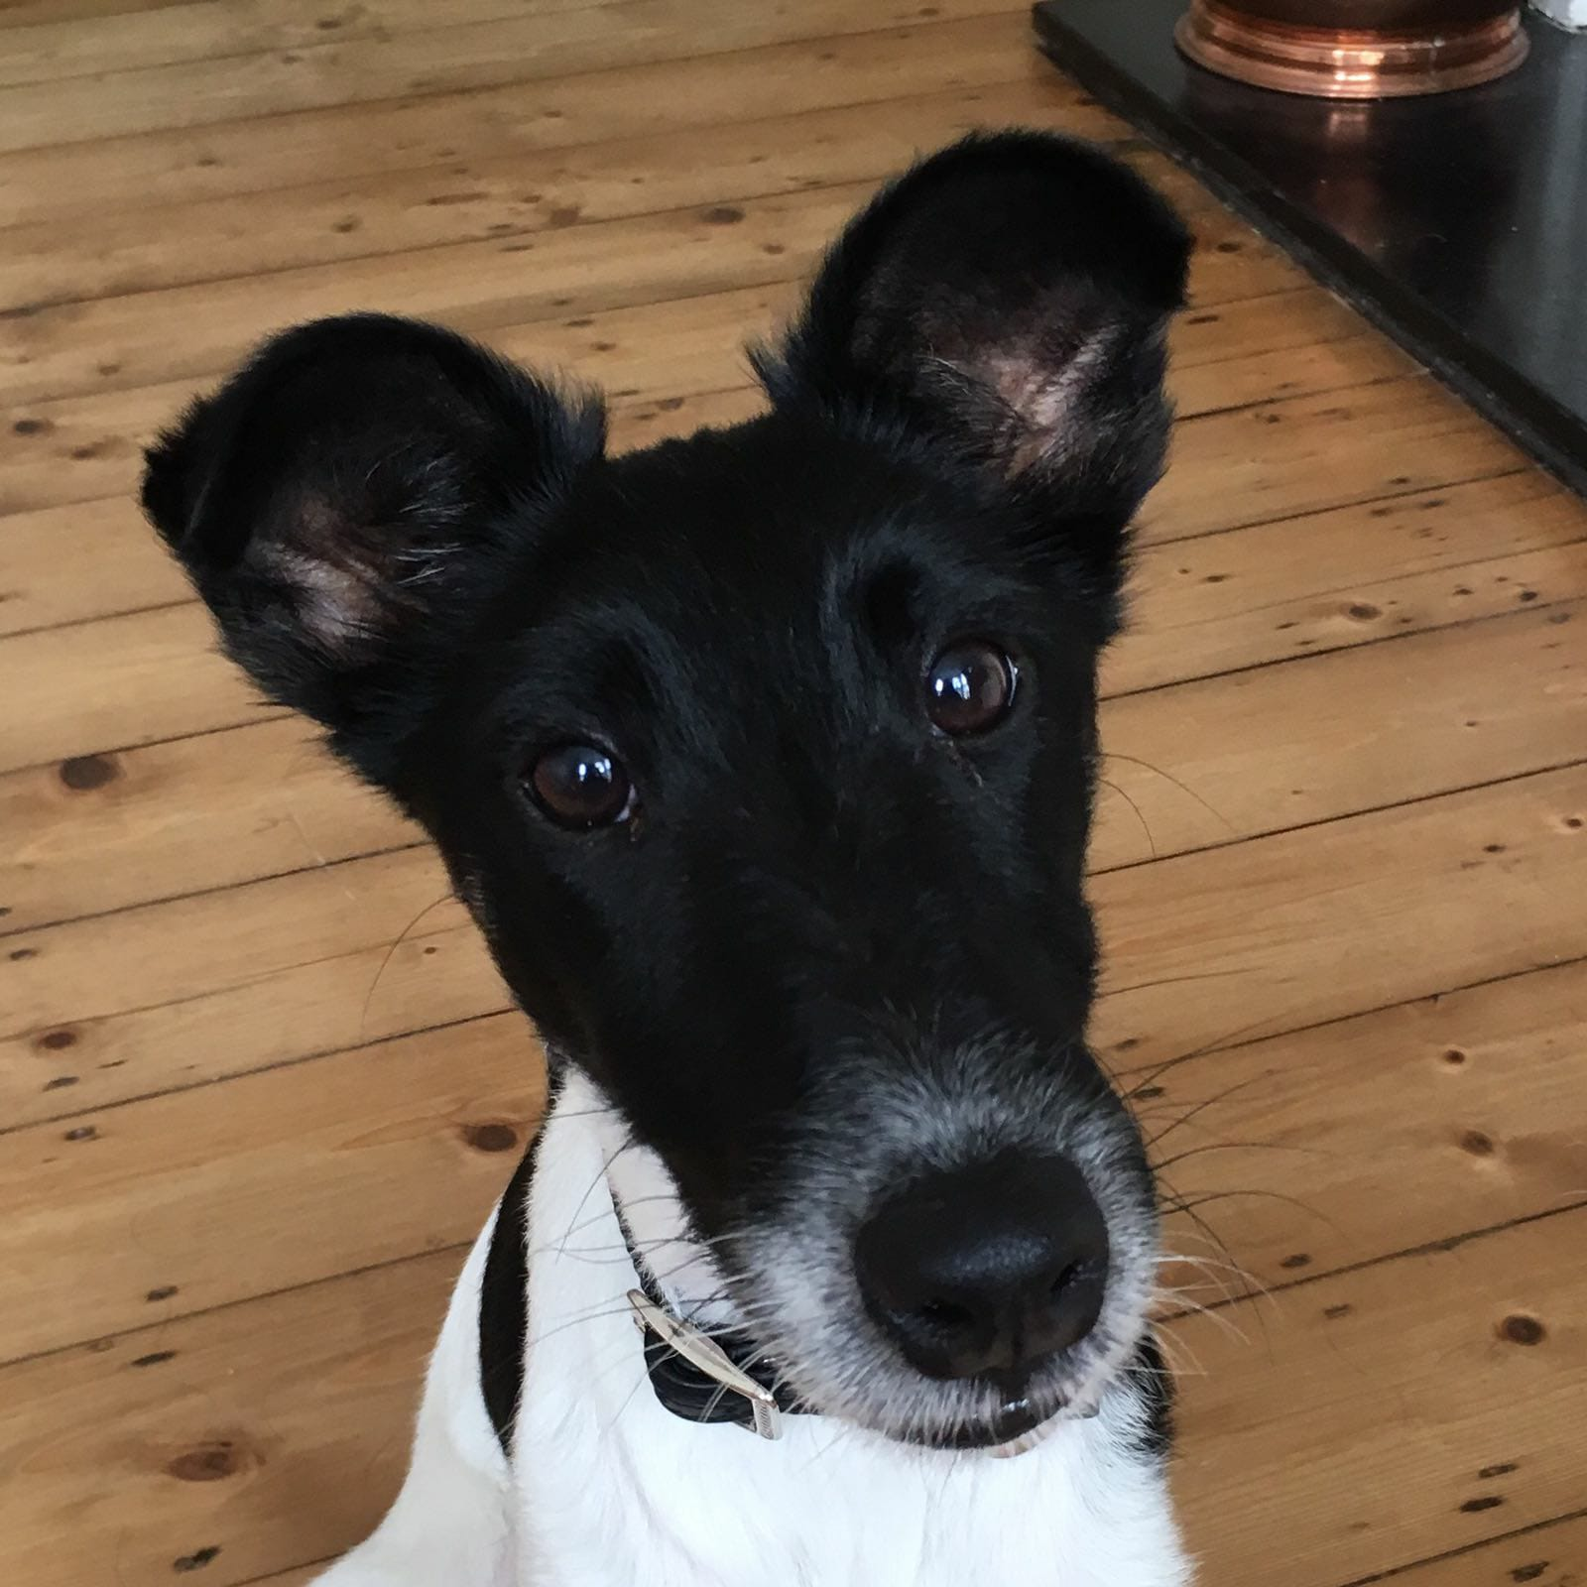
Inspiration

Slide 10
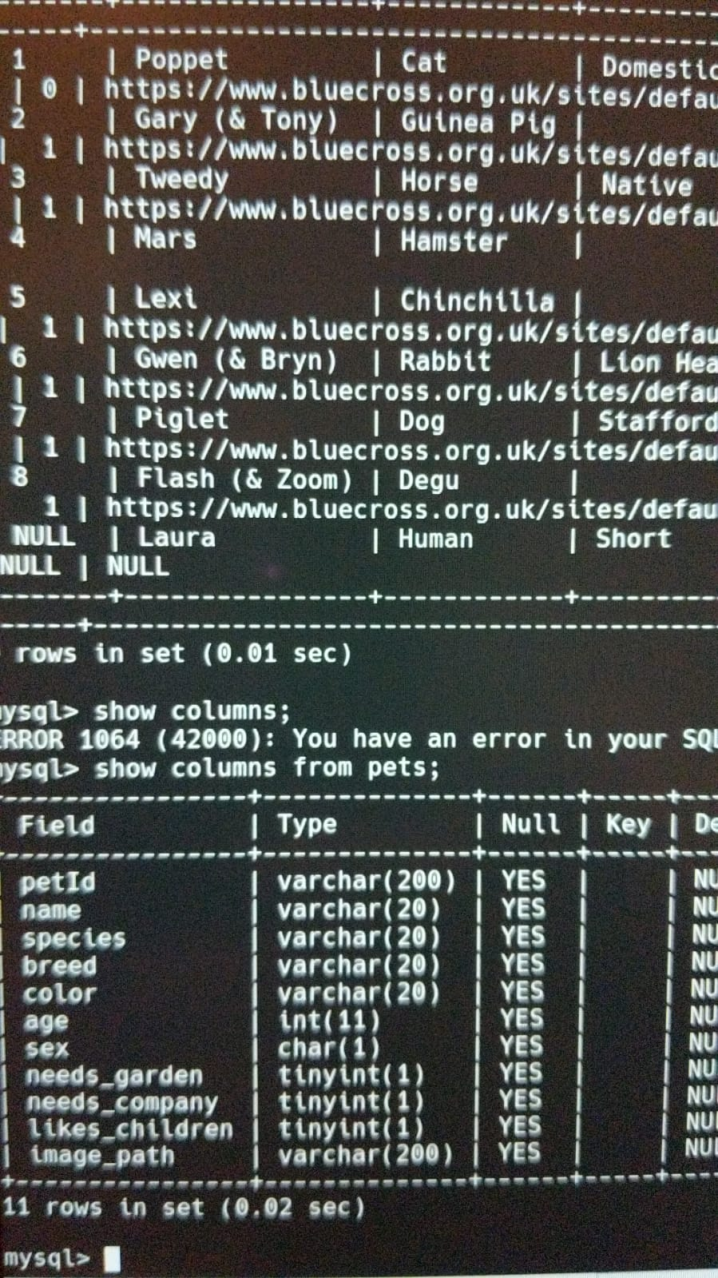
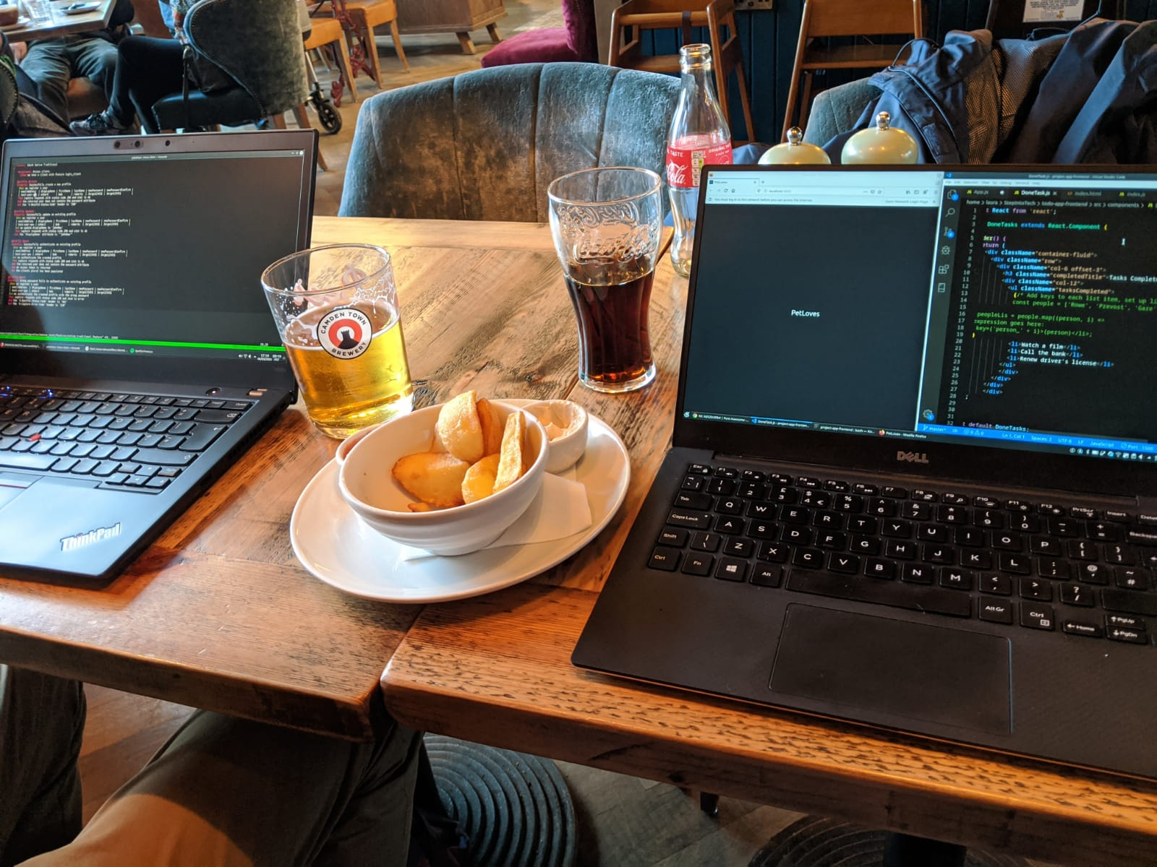
Research

Slide 11
Research
Battersea Dogs Home
https://www.battersea.org.uk/?gclid=CjwKCAjwgbLzBRBsEiwAXVIygI4J4ZSZX6-P5c40rajtzDheXah2J5Nq13wbY18RsTcZK6US3nydkxoC2jUQAvD_BwE
PDSA
https://www.pdsa.org.uk/?_$ja=tsid:67827|cid:258761070|agid:20225634390|tid:kwd-90377080|crid:294826746416|nw:g|rnd:689055166402275185|dvc:c|adp:|mt:e|loc:9045889&gclid=CjwKCAjwgbLzBRBsEiwAXVIygNLvyOhANwyFTG-IXqlDjm6TFekid1w9fp0cdTi0DWnR1GvDnytUXhoCgbYQAvD_BwE
Dogs Trust
https://www.dogstrust.org.uk/rehoming/?gclid=CjwKCAjwgbLzBRBsEiwAXVIygL1cK3OWJR2YcviJWbah0PIaAB0_8phRiOxDatclzuRAERLfx_JQphoCn3UQAvD_BwE&gclsrc=aw.ds

Slide 12
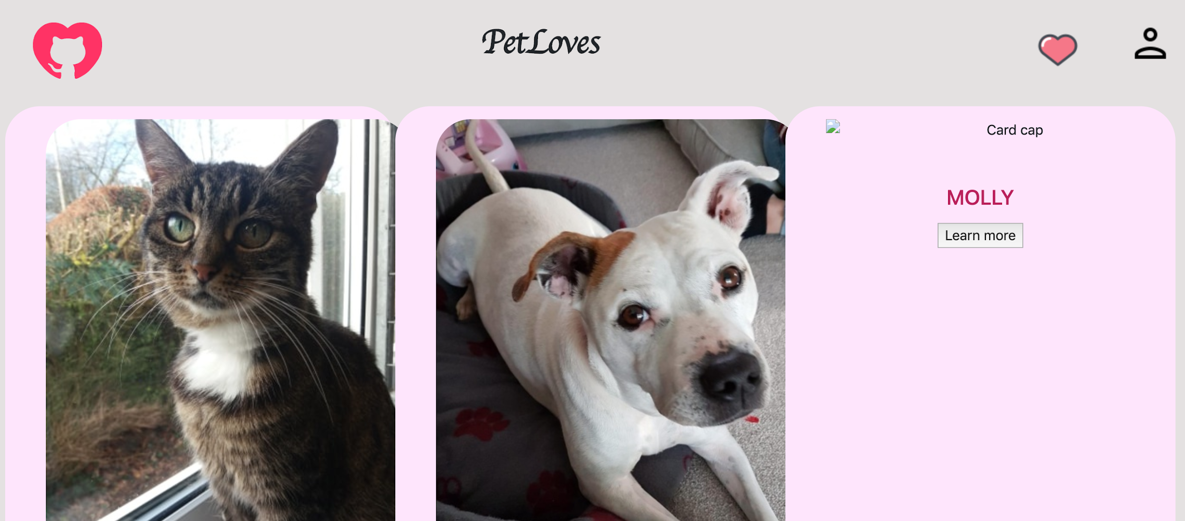
Filming explanation of the app

Slide 13
Project review

